Slide 1

Health Disparities Research
Module 4
Social determinants of health
Session 5

Slide 2
Session 5 overview
Integrative research
Social determinants of health (SDOH)
Socioenvironmental deprivation (SED)
Modeling SED & disparities
Mediation analysis for health disparities
Examples
Ethics

Slide 3
Integrative research

Slide 4
Health disparities research must be integrative
As per the NIMHD mission, we are focused on minority health and health disparities
We study health disparities that along the axis of race and ethnicity
Focus on health outcomes that disproportionately affect socially disadvantaged groups

Slide 5
Health disparities research must be integrative
Racial and ethnic groups differ with respect to
Genetic background
Social environment
Both of these broad classes of risk factors – genetic & socioenvironmental – should be considered in health disparities research
Key challenge is how to decompose their effects
They are correlated across groups

Slide 6
Health disparities & genetic epidemiology
Genetic epidemiology is the study of the role of genetic factors in determining health and disease in families and in populations, and the interplay of such genetic factors with environmental factors
This module focuses on statistical approaches to the genetic epidemiology of health disparities
Focus on genetics, the environment, and their interactions

Slide 7
Social determinants of health (SDOH)
https://www.cdc.gov/public-health-gateway/php/about/social-determinants-of-health.html

Slide 8
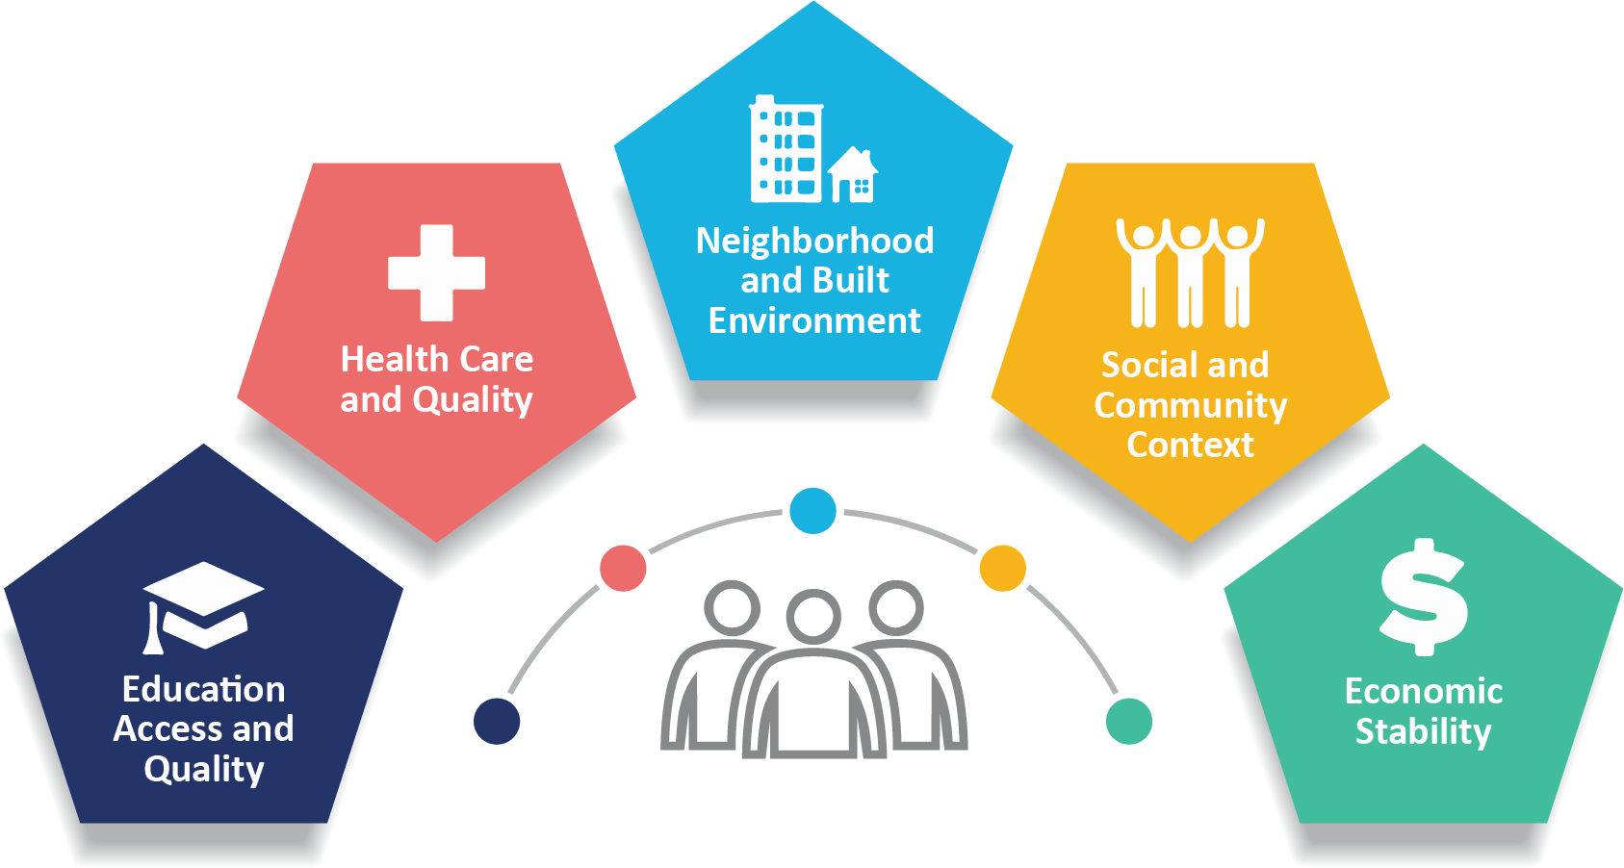
Social determinants of health (SDOH) are non-medical factors that affect health outcomes.

Slide 9
Education examines the relationship between education and health and well-being. Important areas include graduation rates, higher education, educational attainment, language and literacy, and early childhood education and development.

Slide 10
Health and healthcare looks at how people's access to and understanding of health services impact their health. Issues include healthcare access, health insurance coverage, English language proficiency, health literacy, and the health implications for people who migrate to or within the United States, even temporarily.

Slide 11
Neighborhood and built environment explores the relationship between where people live (like housing, neighborhoods, and overall environment) and their health and well-being. Topics include housing quality, access to transportation, availability of healthy foods, water and air quality, and community violence and crime.

Slide 12
Social and community context focuses on how the characteristics of environments where people live, learn, work, and play affect their health and well-being. It covers topics like community cohesion, civic participation, discrimination, racism, xenophobia, cultural norms, interpersonal violence, workplace conditions, and incarceration. Another contextual factor is immigration status, especially for people who migrated from less-developed countries.

Slide 13
Economic stability explores the link between people's financial resources (like income, cost of living, and socioeconomic status) and their health. Key issues include poverty, employment, food security, and housing stability.

Slide 14
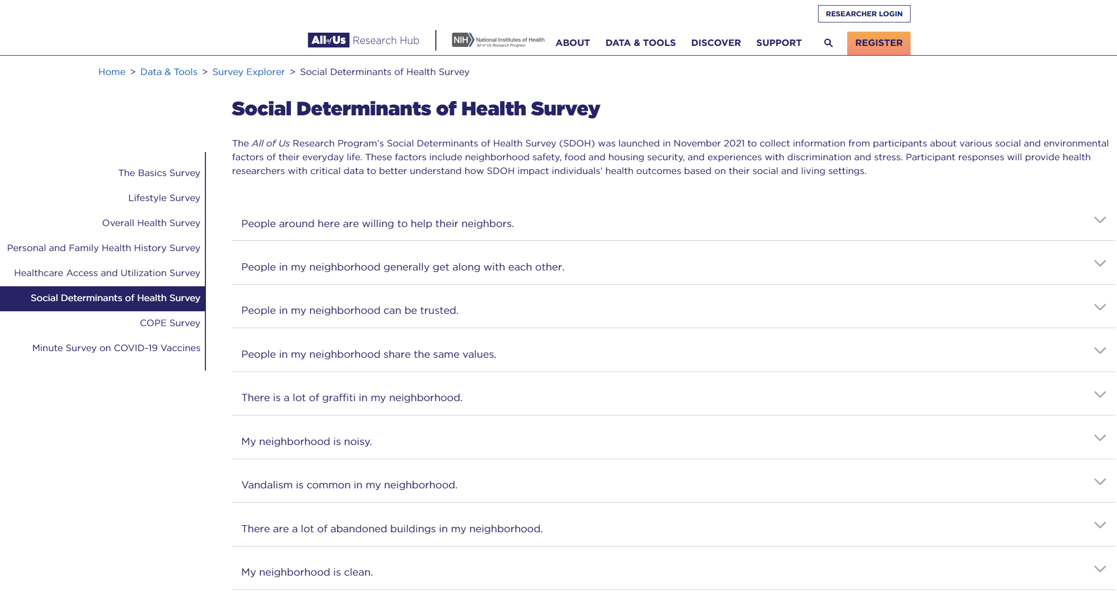
https://www.researchallofus.org/data-tools/survey-explorer/social-determinants-survey/

Slide 15

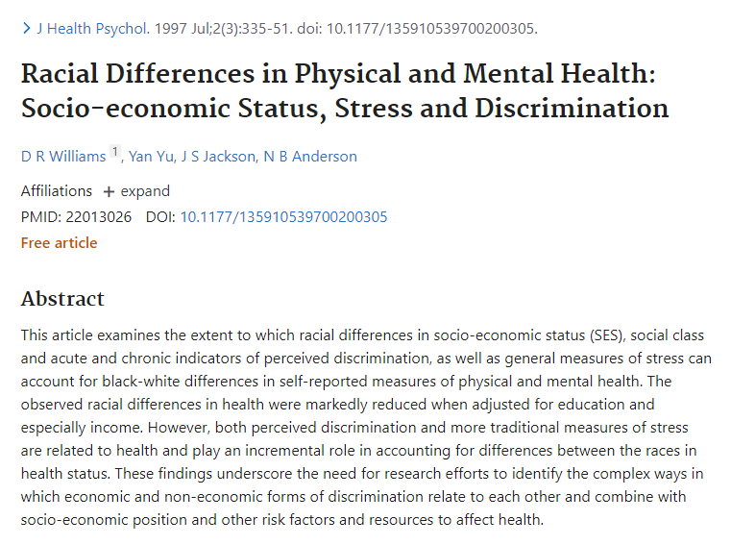

Slide 16
Socioeconomic deprivation (SED)

Slide 17
Socioeconomic deprivation (SED)
Lack of the social, economic, and material resources that are required to ensure overall well-being and standard of living
Can be measured by a variety of factors, including education, employment, income, and housing
Numerous health outcomes, and in particular health disparities between social groups, have been associated with socioeconomic deprivation
Can affect health outcomes via limited access to healthcare, elevated stress, unhealthy behaviors, and harmful environmental exposures

Slide 18
Place-based SED
SED is often measured at the area-level using composite indices that combine measures across multiple dimensions of deprivation
Community deprivation index combines socioeconomic variables on education, health insurance, housing, income, and poverty from the American Community Survey
https://github.com/geomarker-io/dep_index

Slide 19
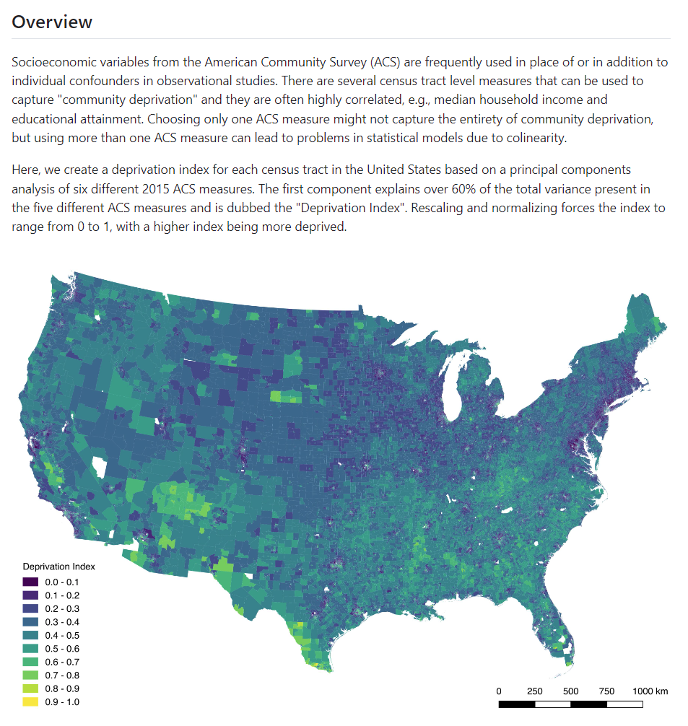

Community deprivation index
https://github.com/geomarker-io/dep_index

Slide 20
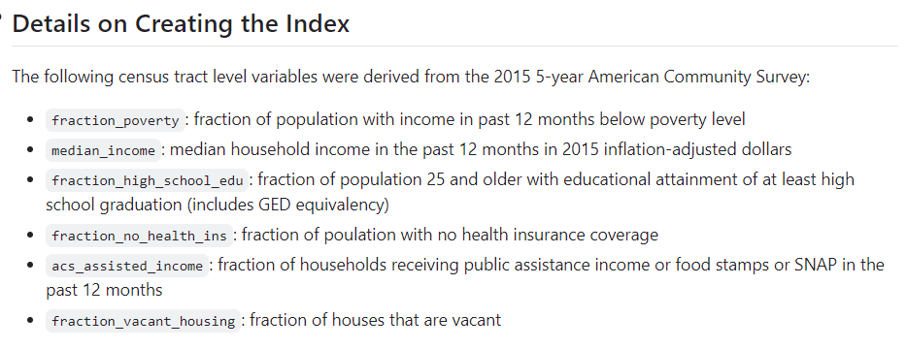
Community deprivation index
https://github.com/geomarker-io/dep_index

Slide 21
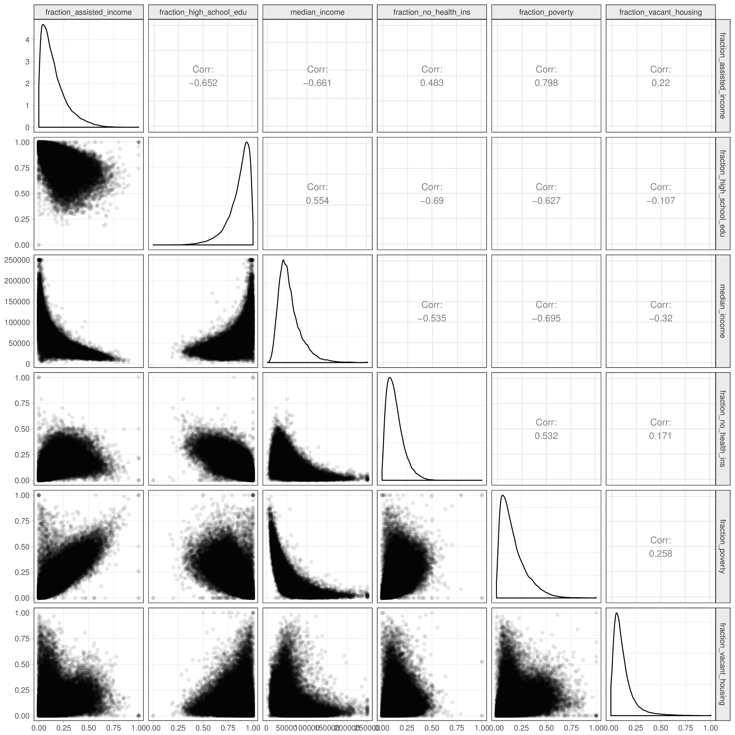
Community deprivation index
https://github.com/geomarker-io/dep_index

Slide 22
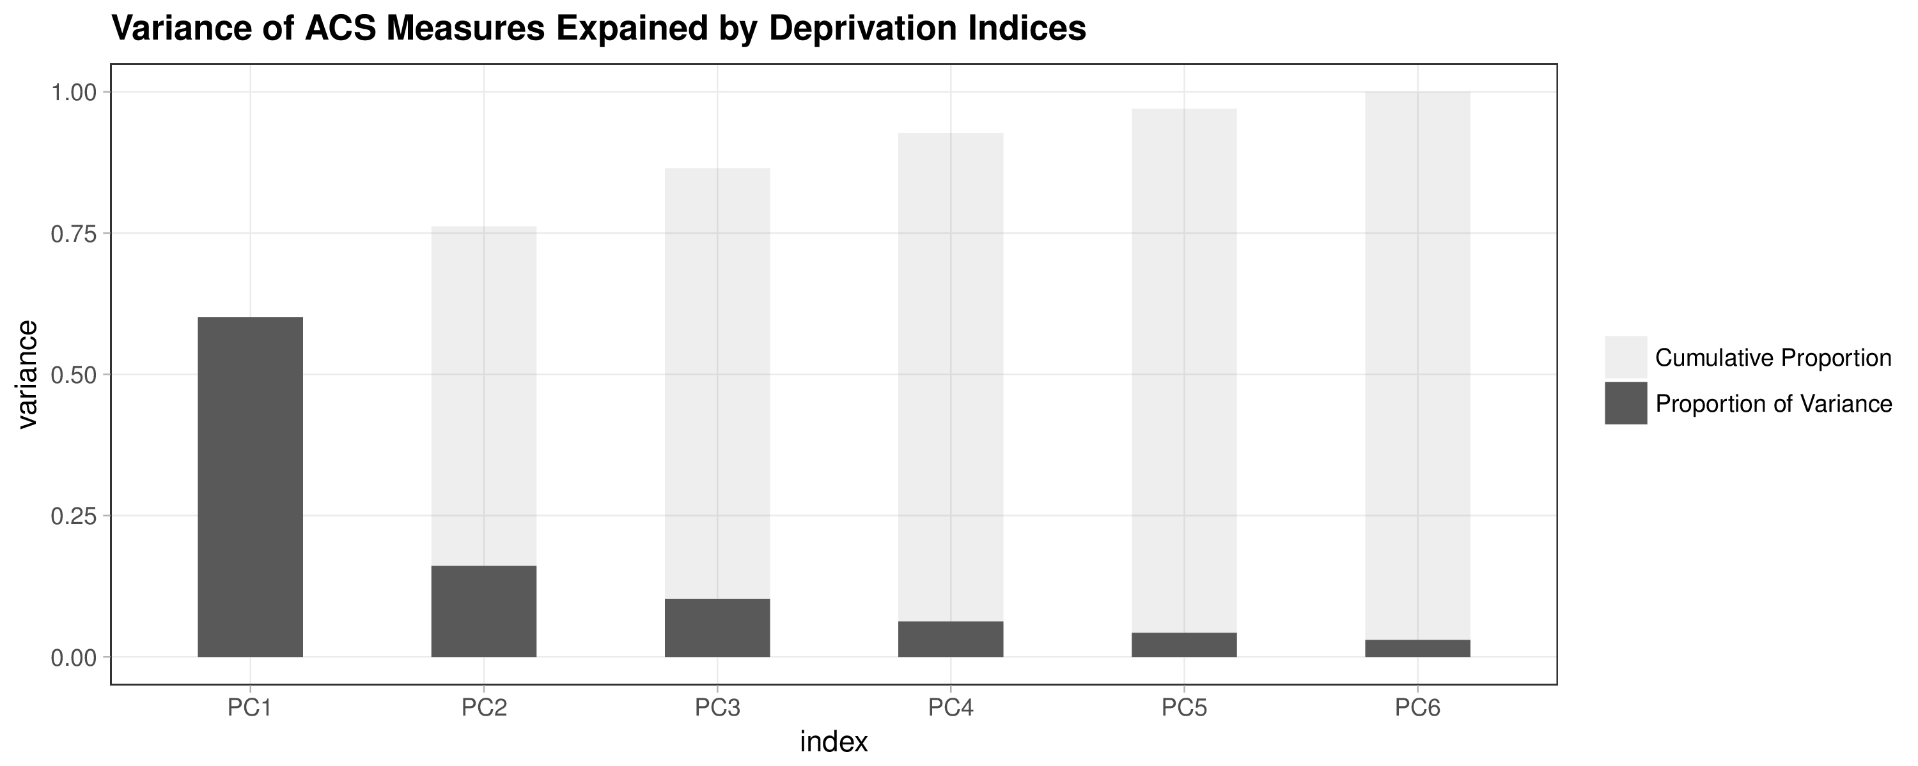
Community deprivation index
https://github.com/geomarker-io/dep_index

Slide 23
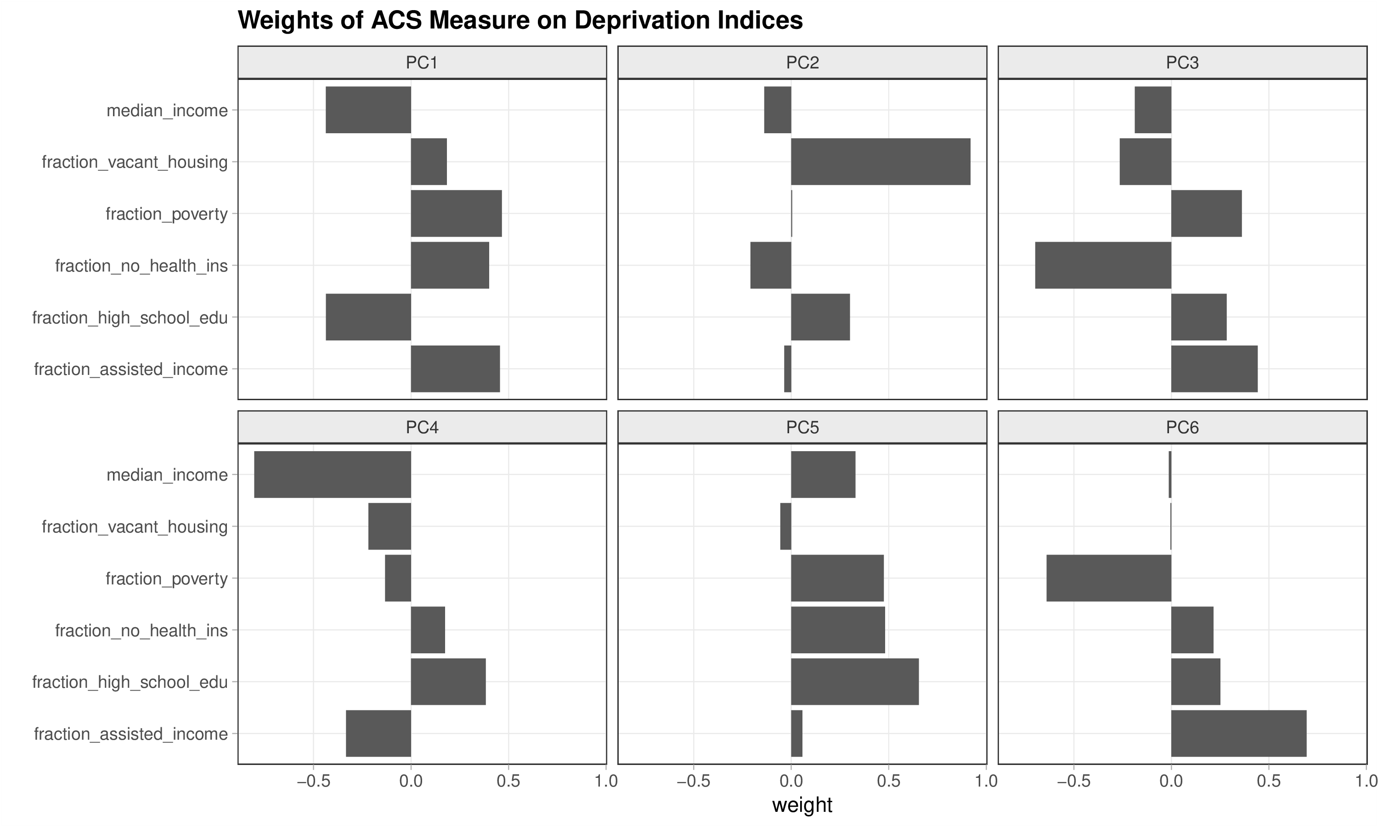
Community deprivation index
https://github.com/geomarker-io/dep_index

Slide 24
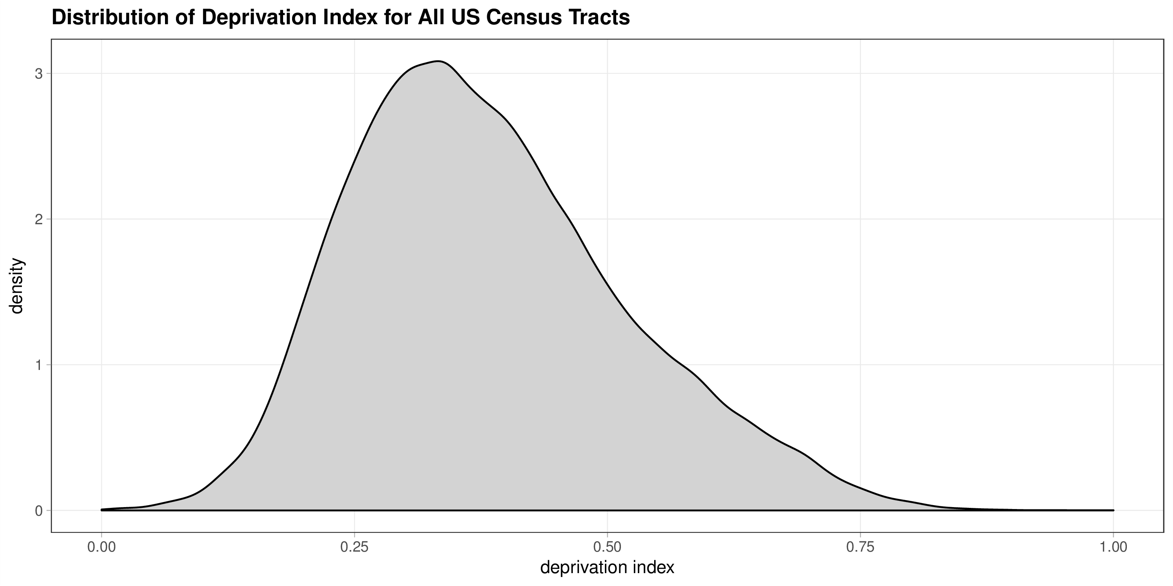
Community deprivation index
https://github.com/geomarker-io/dep_index

Slide 25
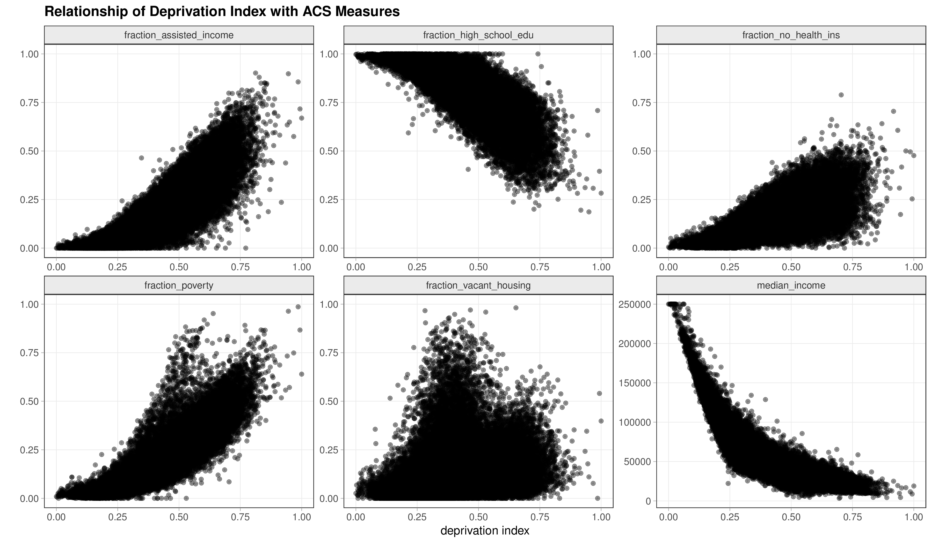
Community deprivation index
https://github.com/geomarker-io/dep_index

Slide 26
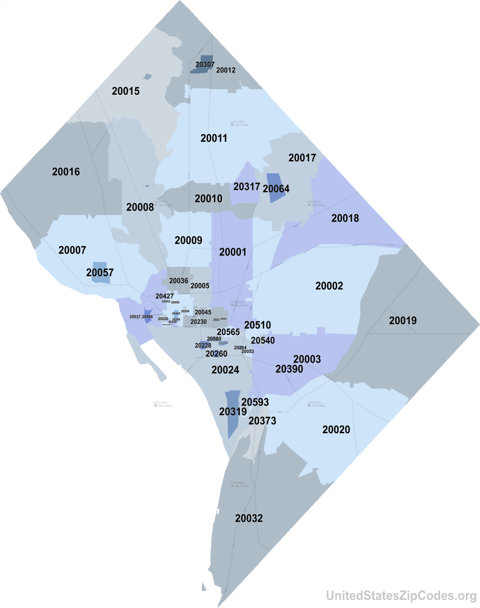
Individual-level SED
Washington DC
Depending on the level of granularity, using place-based SED may result in participants with different individual-levels of socioeconomic deprivation being assigned the same place-based SED
Eg All of Us uses 3-digit zipcodes

Slide 27
Individual-level SED: All of Us
Objective 1: derive a quantitative measure of individual-level socioeconomic deprivation using All of Us survey questions
Objective 2: analyze associations of the derived socioeconomic deprivation metric with health outcomes and disparities in the All of Us cohort

Slide 28

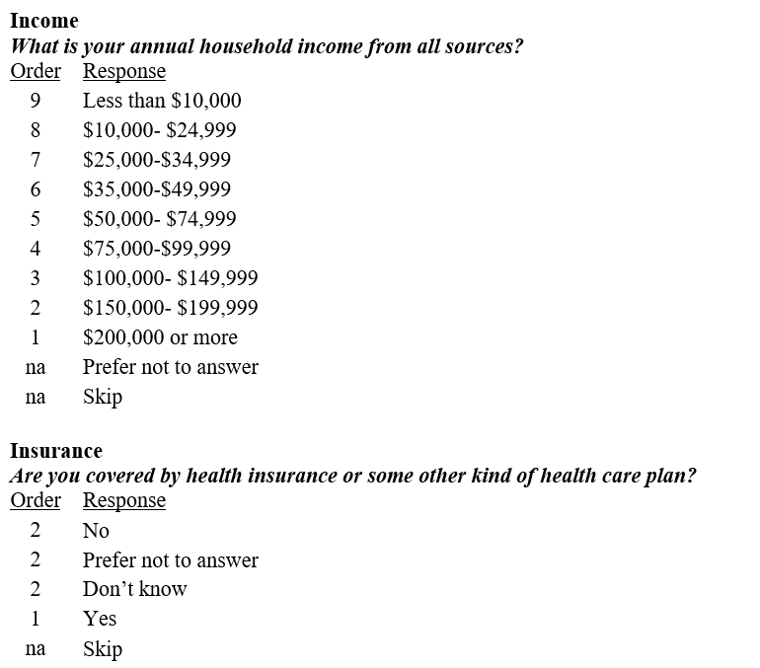
Individual-level SED: All of Us
Basics Survey questions and responses (ordinal coding)

Slide 29
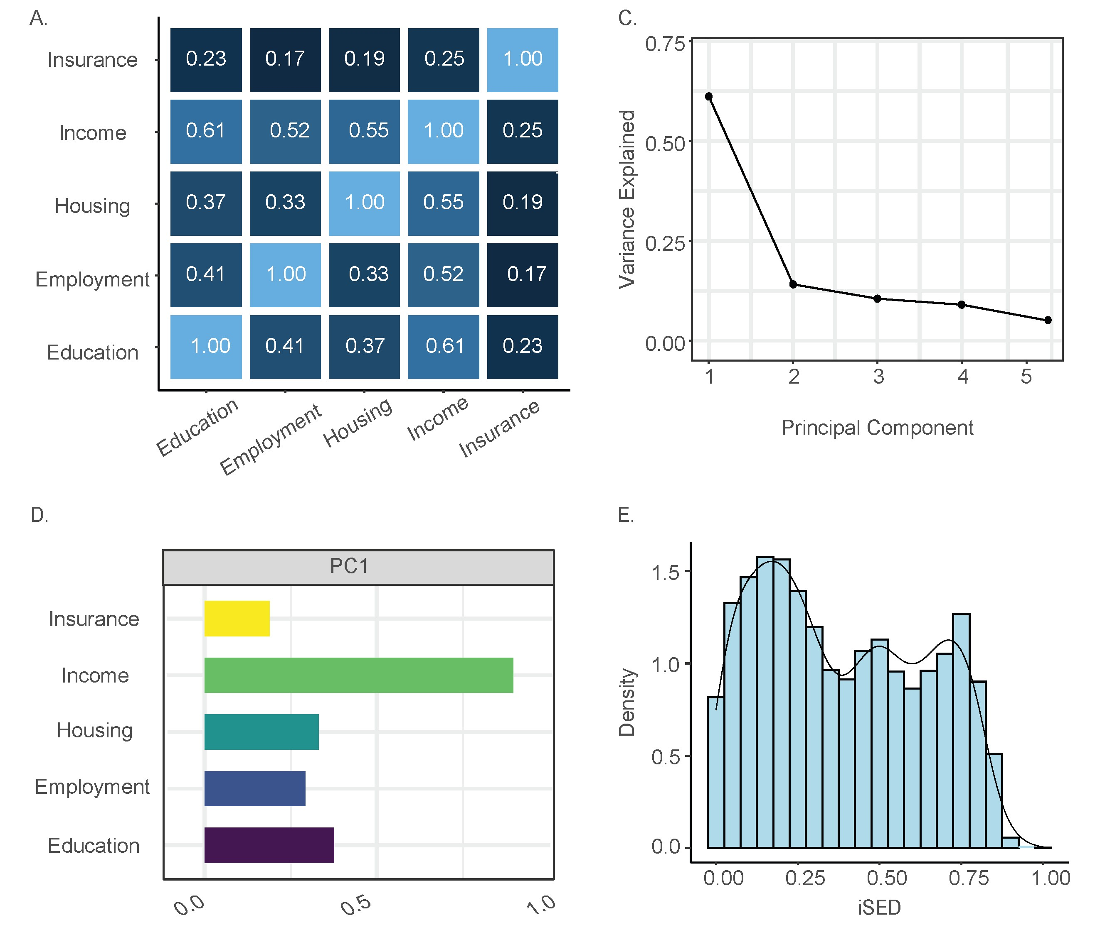
Individual-level SED: All of Us
Variables are correlated but not perfectly
Using any one of these variables alone will not capture all aspects of participant socioeconomic deprivation, while using two or more of the variables could lead to multicollinearity in health outcome association models

Slide 30
Individual-level SED: All of Us
First principal component (PC) explains 61.18% of the variance in the participant survey data
Variable loadings for PC1 are all positive, with greater values indicating higher socioeconomic deprivation

Slide 31
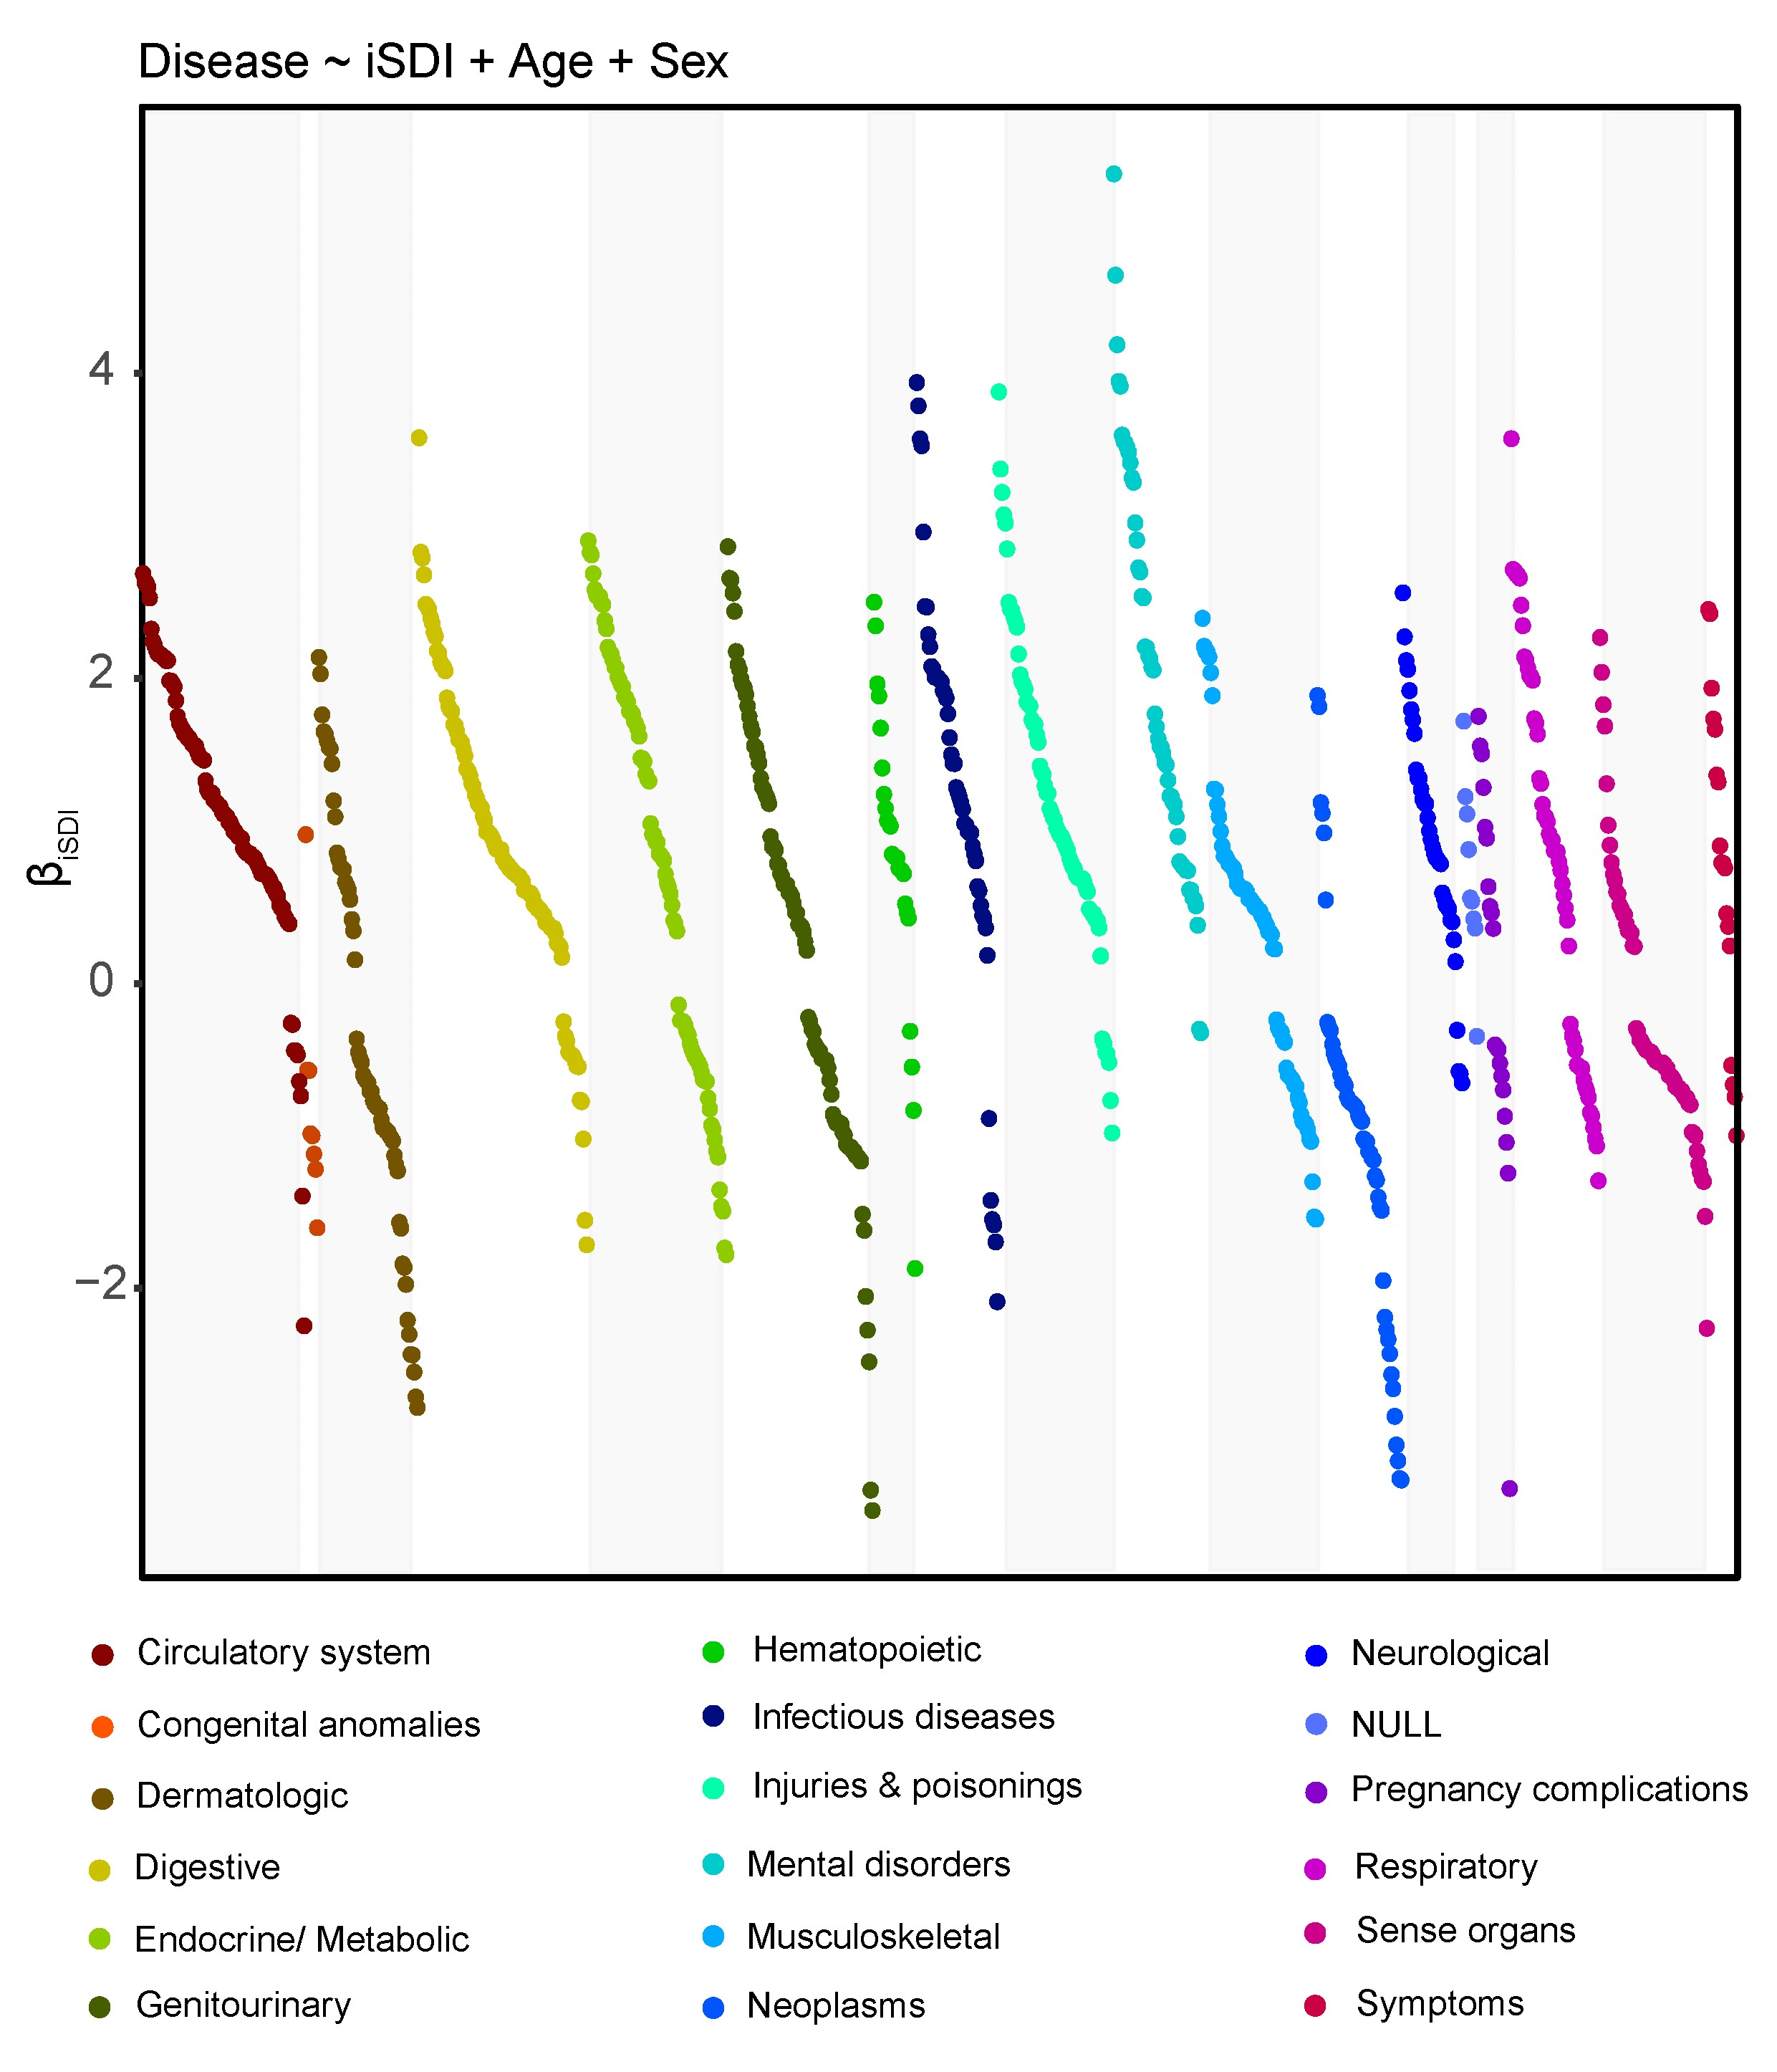
Individual-level SED: All of Us
iSDI – individual-level socioeconomic deprivation index
Modeled against 1,755 disease outcomes (using phecodes)

Slide 32
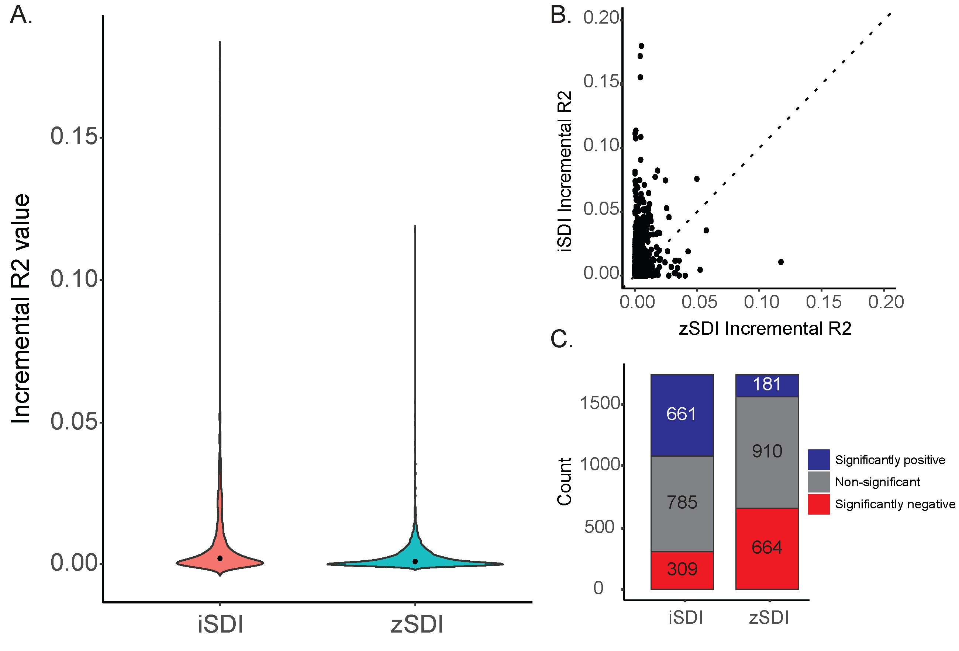
Individual-level SED: All of Us
Individual-level socioeconomic deprivation (iSDI) explains more of the variance in disease outcomes than place-based socioeconomic deprivation (zSDI)
Nevertheless, iSDI and zSDI are complementary
Use both!

Slide 33
Modeling SED & disparities

Slide 34
Multivariable regression for health disparities
Multivariable modeling of health outcomes with race/ethnicity (SIRE) and base covariates (age & sex) can tell us if we have a disparity
Significantly positive or negative coefficient for race/ethnicity term in model
Adding other potential predictors in the model can tell us if the effect of race/ethnicity on the health outcome of interest is attenuated – meaning that these risk factors ‘explain’ the disparity (to some extent)
Social determinants of health (SDOH)
Genetic ancestry (GA)

Slide 35
Multivariable regression: unadjusted
Logistic regression can be used to evaluate associations of race/ethnicity with health outcomes
Controlling for age and sex
Unadjusted model
$$Y= β_{0}+β_{SIRE.Unadj}SIRE+β_{Age}Age+β_{Sex}Sex+ε$$

Slide 36
Multivariable regression: adjusted
Socioeconomic deprivation can be included in
Adjusted model
$$Y= β_{0}+β_{SIRE.adj}SIRE+β_{SDOH}SDOH+β_{Age}Age+β_{Sex}Sex+ε$$

Slide 37
Multivariable regression: unadjusted vs. adjusted
Compare SIRE effect sizes for unadjusted and adjusted models
To what extent does the inclusion of SDOH in the model explain (attenuate) the effects of SIRE
$$Attenuation={(β_{Unadj.SIRE}−β_{Adj.SIRE})}/{β_{Unadj.SIRE}}$$
*simple approach with assumptions that are often violated

Slide 38
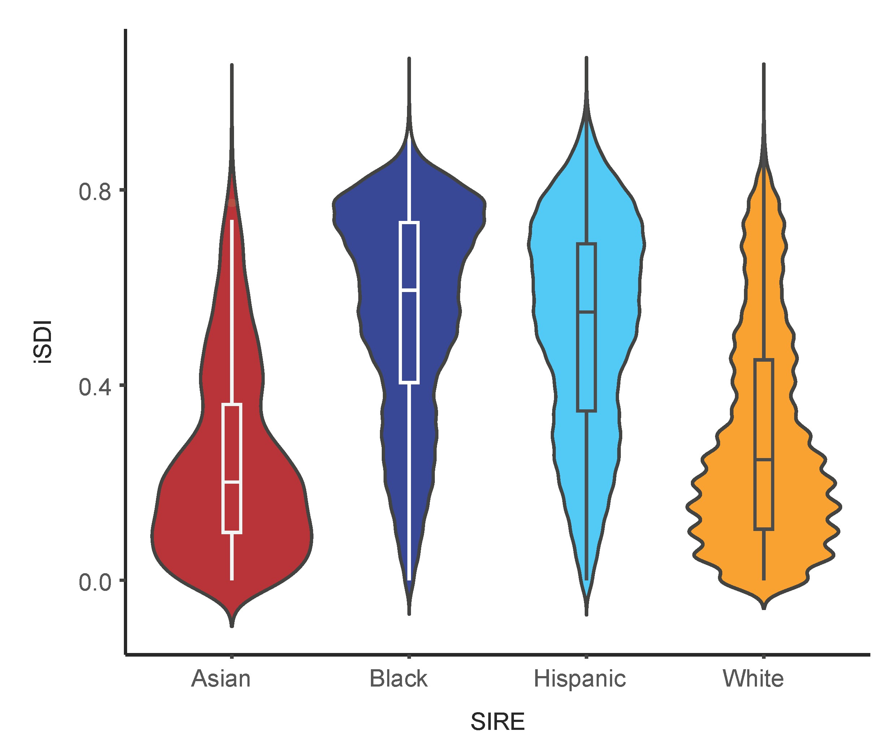
Individual-level SED: All of Us
iSDI varies between self-identified race/ethnicity (SIRE) groups*
Relevant for disparities?
*more variation within than between groups

Slide 39
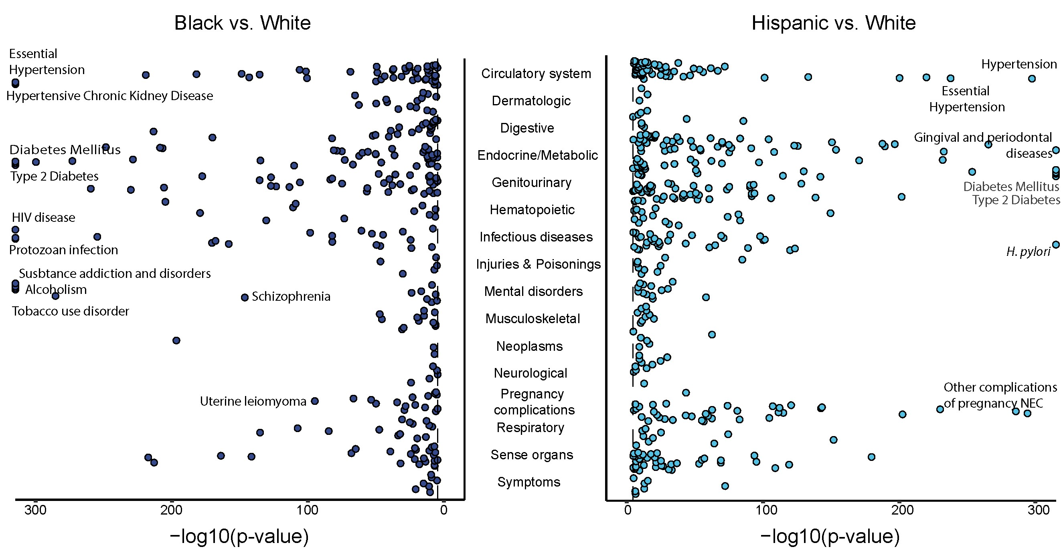
Individual-level SED: All of Us
Characterize disparities for Black and Hispanic participants (White reference group)

Slide 40
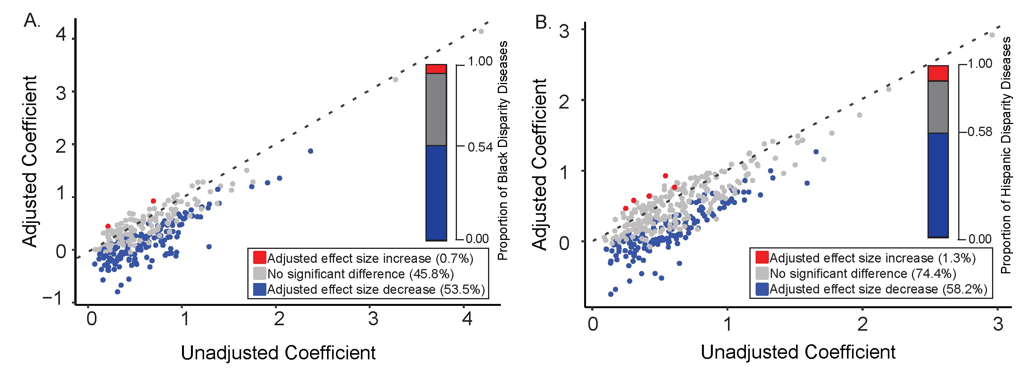
Individual-level SED: All of Us
Compare iSDI adjusted and unadjusted effects of Black SIRE on health disparities
iSDI attenuates the effect of Black SIRE for 53.5% of disparity diseases

Slide 41
Individual-level SED: All of Us
Compare iSDI adjusted and unadjusted effects of Hispanic SIRE on health disparities
iSDI attenuates the effect of Hispanic SIRE for 58.2% of disparity diseases

Slide 42
Mediation analysis for health disparities

Slide 43
Mediation analysis
We wish to understand the mechanisms that underlie health disparities
Mediation analysis has been proposed as an ideal tool for this purpose
Race/ethnicity groups differ wrt genetics and social determinants of health
Mediation analysis can help to decompose the relative contributions of each class of risk factor to health disparities

Slide 44
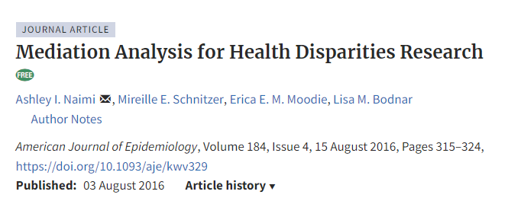
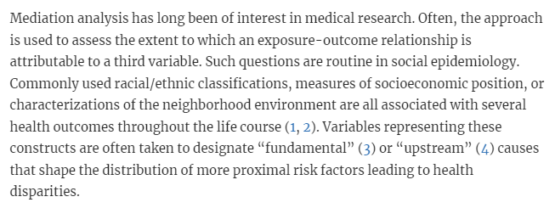

Slide 45
Directed acyclic graph (DAG)
Intuitive means to communicate causal questions in epidemiological research
Inform study design and statistical analysis
Graphical structure used to encode researchers’ a priori assumptions about the relationships between variables in a causal path
Path = unbroken sequence of nodes connected by edges
Directed path = follow the edges in the direction indicated by the arrows

Slide 46
Directed acyclic graph (DAG)
Assess the extent to which an exposure (X) is associated with an outcome (Y)
X
Z
Upstream
exposure
Outcome

Slide 47
DAG: mediation
Assess the extent to which an exposure-outcome relationship is attributable to a third variable
Proximal
risk factor
Y
X
Z
Upstream
exposure
Outcome

Slide 48
DAG: mediation for health disparities
Assess the extent to which a health disparity is attributable to a proximal risk factor
Proximal
risk factor
SDOH
Race
Disease
outcome
Upstream
exposure
Outcome

Slide 49
Mediation for health disparities
Assess the magnitude of the disparity that would remain if a downstream risk factor were changed
Caveat: debate about causal status of non-manipulable exposures like race and ethnicity
No causation without manipulation
Violates assumptions of simple (traditional) approaches
Counterfactual methods are robust under the health disparities framework *
*beyond the scope of this course but see Naimi et al. review

Slide 50
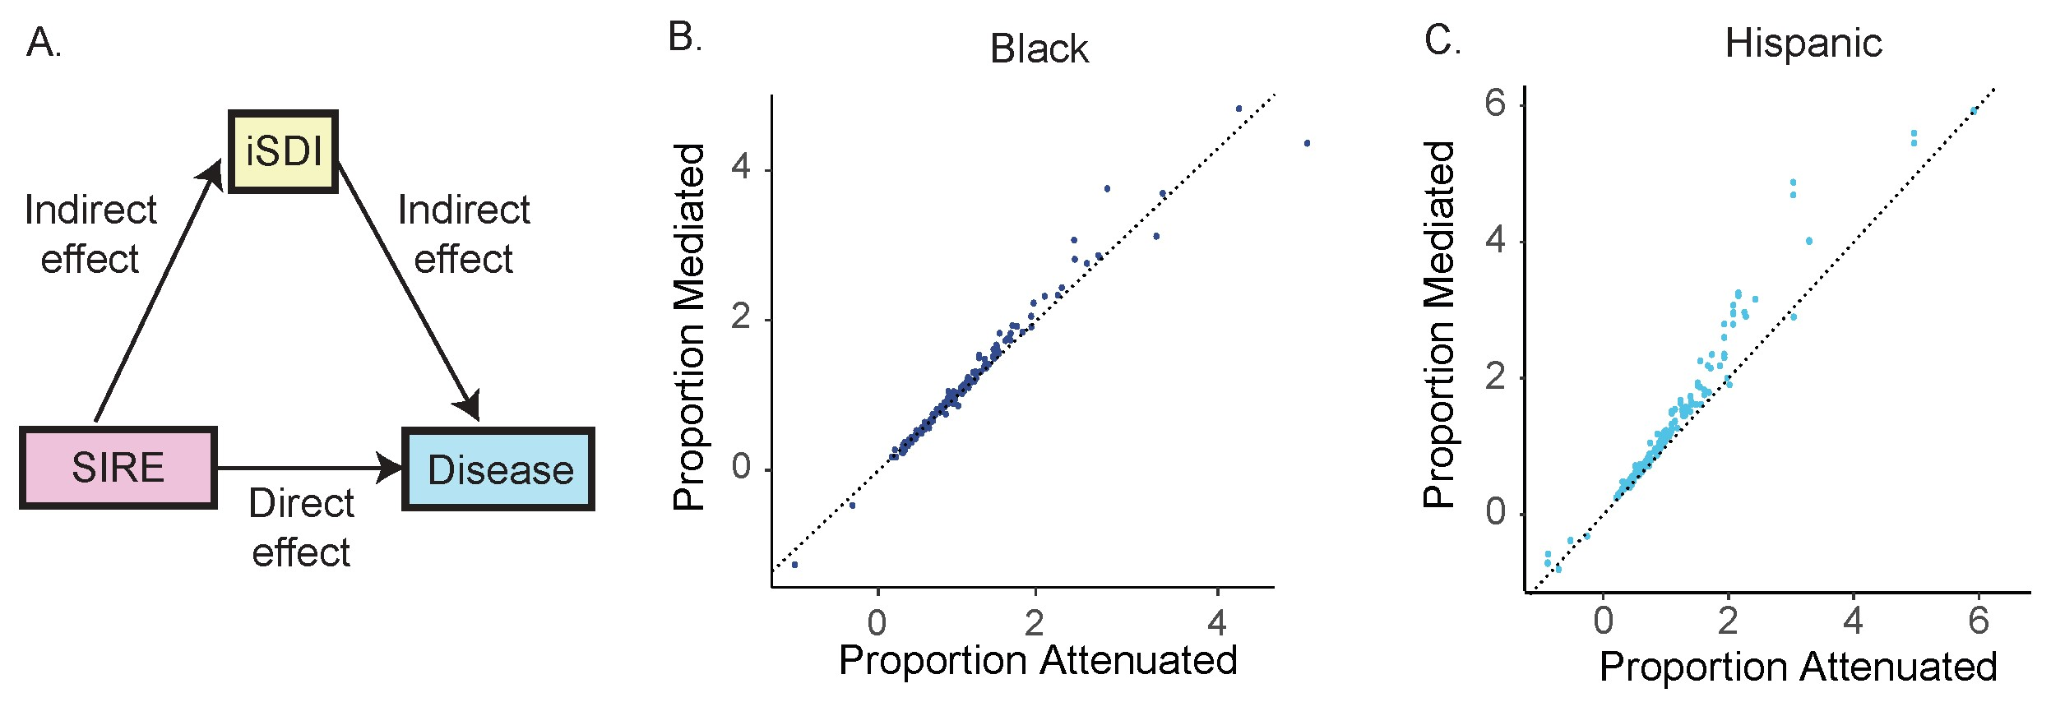
Individual-level SED: All of Us
Despite violations of assumptions, counterfactual mediation analysis yields similar results to the simple attenuation method for All of Us study

Slide 51
Examples

Slide 52
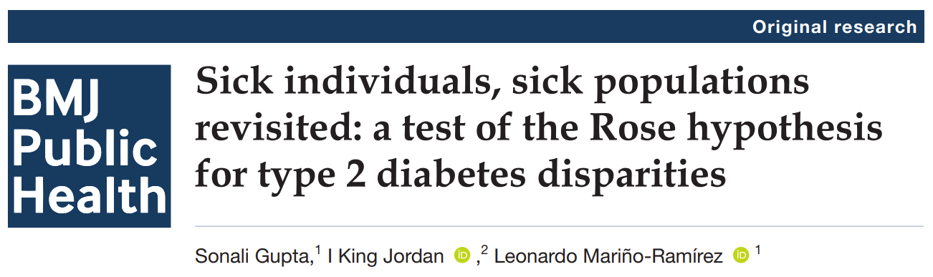
Question: how do the causes of individual-level disease cases relate to group-level disparities
Geoffrey Rose predicted that distinct classes of risk factors will explain individual-level disease cases (genetic risk factors) versus group-level disparities (environmental risk factors), owing to their within-group versus between-group variance components.

Slide 53
Genetic risk factors show greater within than between group variation
Individual-level but not group-level effects
SDOH show greater between than within group variation
Group-level but not individual-level effects

Slide 54
Objective: interrogate the Rose hypothesis for genetic versus environmental risk factors of individual disease cases versus population disease disparities for type 2 diabetes (T2D) in the UK.
Use mediation analysis to decompose the effects of genetic risk factors and SDOH on T2D disparities in the UK

Slide 55
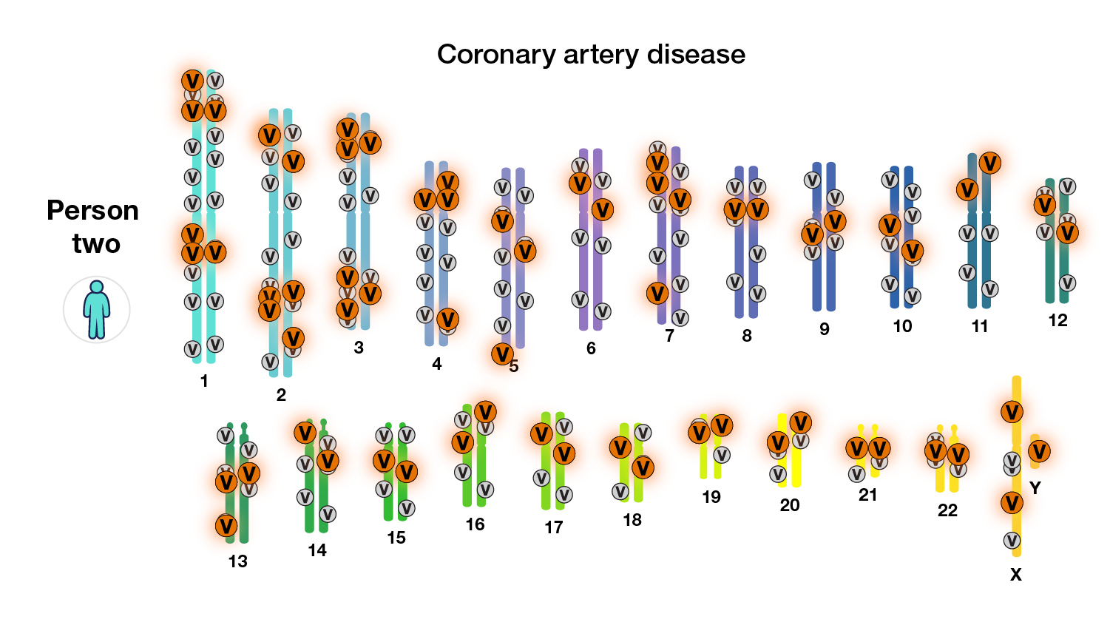
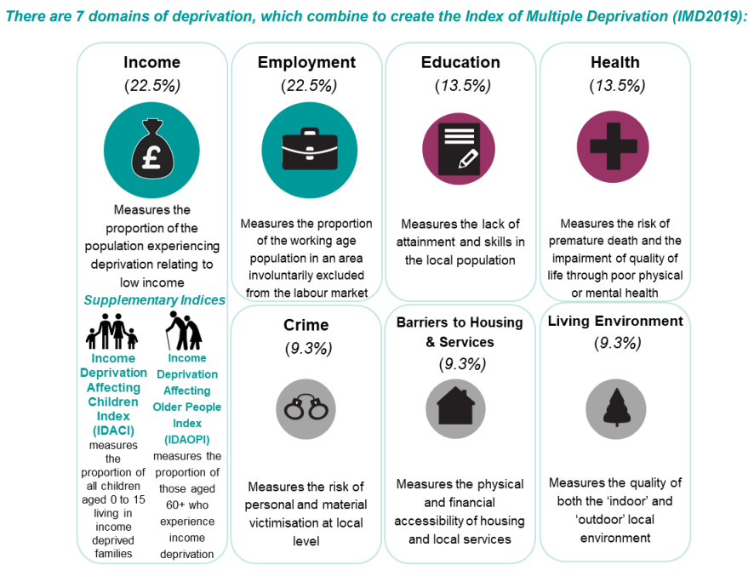
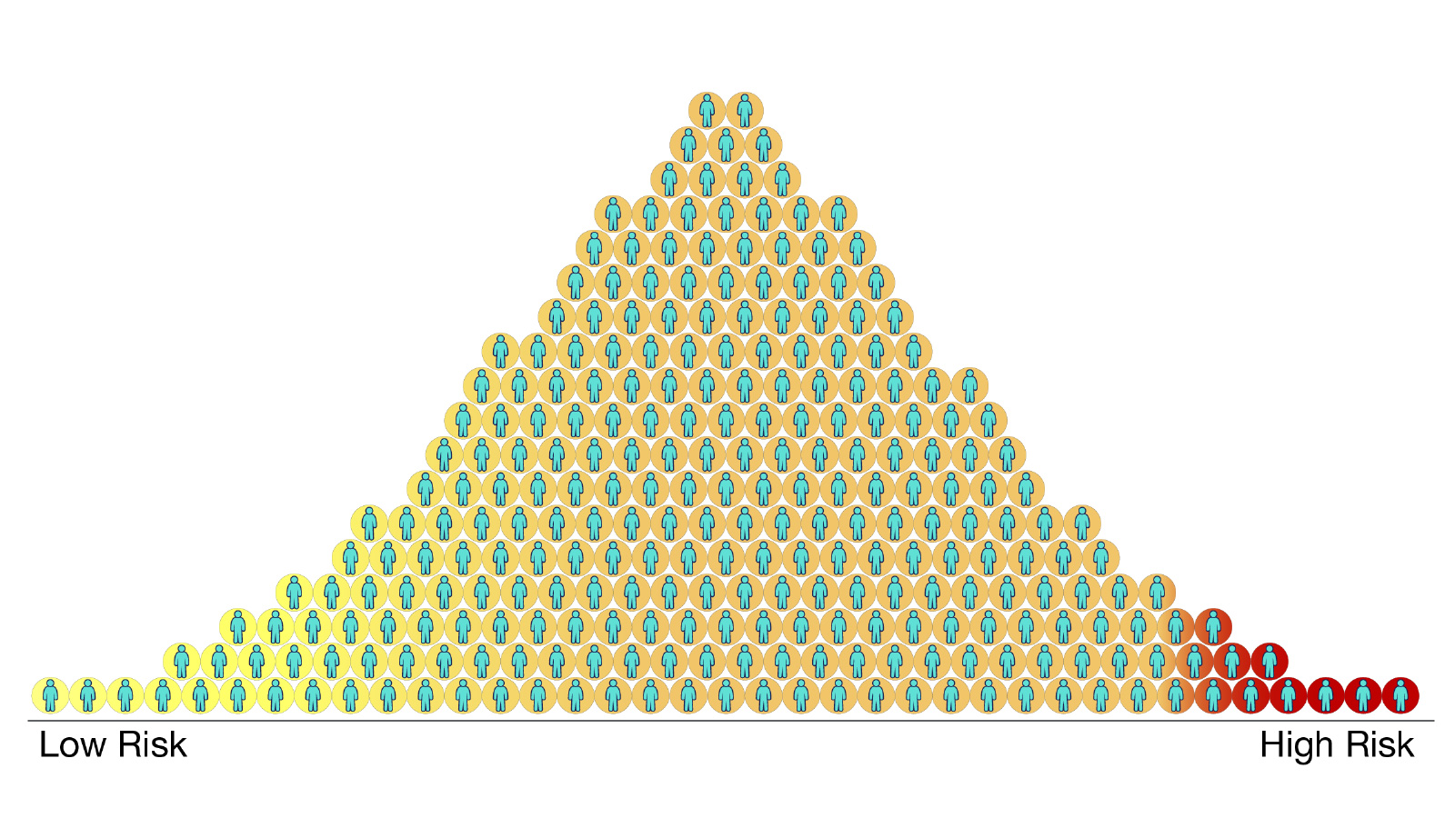
Genetic risk factor
SDOH: SED
Townsend deprivation index (TDI) and Index of Multiple Deprivation (IMD)
Polygenic risk score (PRS) – weighted sum of the number of risk increasing alleles in a genome
T2D risk alleles (V)
PRS

Slide 56
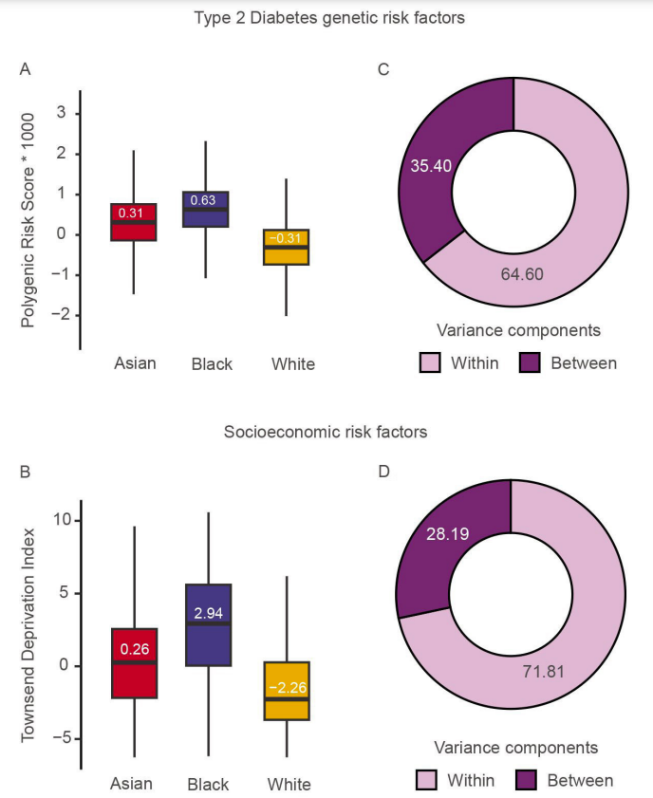
Genetic and socioeconomic T2D risk factors vary between groups
Both genetic and socioeconomic T2D risk factors show greater variation within than between ethnic groups

Slide 57
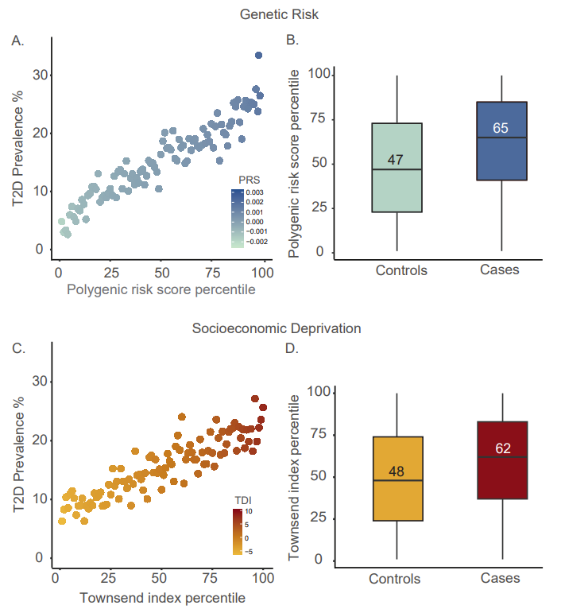
Genetic and socioeconomic risk factors are associated with individual-level T2D risk

Slide 58
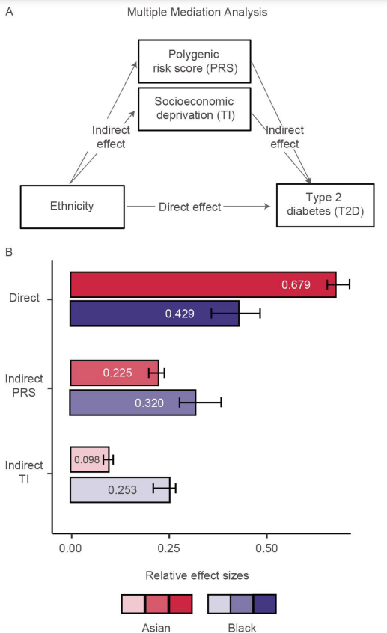
Genetic and socioeconomic risk factors mediate T2D ethnic disparities

Slide 59
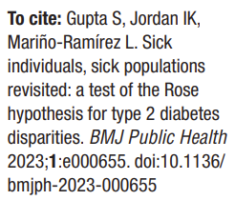
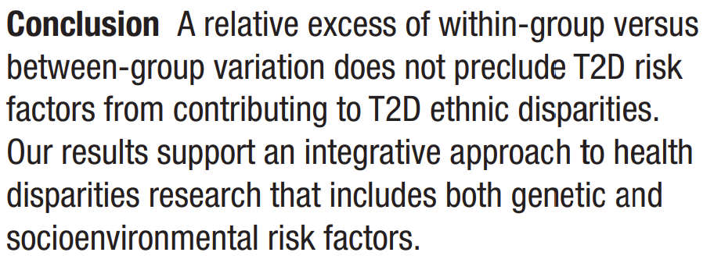

Slide 60
Questions for the practical lab session
How can the effects of socioeconomic deprivation (SED) on health disparities be evaluated using:
Multivariable logistic regression?
SED adjusted versus unadjusted models?
Mediation analysis

Slide 61
Ethics

Slide 62
Logical fallacies in health disparities research
Logical fallacy = use of invalid or otherwise faulty reasoning in the construction of an argument that may appear to be well-reasoned if unnoticed
Can lead to unsupported conclusions
Care must be taken to avoid logical fallacies in health disparities (or any) research

Slide 63
Logical fallacies in health disparities research
Tautologies
Moralistic fallacy

Slide 64
Tautology
Self-contained deductive argument
Consists of premise (axiom) and conclusions that follow logically (inevitably) from premise
Premise does not need to have empirical correspondence
Do not make any falsifiable predictions
Tell us nothing new about the world

Slide 65



Structure of tautologies
Premise
(axiom)
Observation
(finding)
Conclusion
(deduction)
All cats have four legs
It is a cat
It has four legs

Slide 66


Slide 67
Structure of tautologies
Premise
(axiom)
Observation
(finding)
Conclusion
(deduction)
Health disparities are caused by social disadvantage
Disease X is a health disparity
Disease X is caused by social disadvantage
Leads to myopic focus on one potential set of causes, can obscure other causes

Slide 68
Moralistic fallacy
https://www.psychologytoday.com/us/blog/the-scientific-fundamentalist/200810/two-logical-fallacies-we-must-avoid
The logical leap from what ought to be to what is
The way things should be is the way they are
Reverse naturalistic fallacy
“Because everybody ought to be treated equally, there are no innate genetic differences between people”.

Slide 69
Moralistic fallacy
https://www.psychologytoday.com/us/blog/the-scientific-fundamentalist/200810/two-logical-fallacies-we-must-avoid
Can be avoided by eliminating ought from scientific discourse
Science is about describing the world as it is not how we wish it to be
Moral conclusions should not be drawn from empirical observations

